Slide 1
Strongly-typed System F in GHC
Stephanie Weirich
University of Pennsylvania
Chalmers FP seminar
June 22, 2020
https://github.com/sweirich/challenge/

Slide 2

Announcement: ICFP 2020
ONLINE conference, August 23-28
https://icfp20.sigplan.org/
Accepted paper list is out!
Now open: Call for tutorials, panels and discussions
Any topic of interest to FP community, broadly interpreted
Submit proposal by July 22nd

Slide 3

A Challenge Problem
Create a strongly-typed representation of System F terms, using your favorite programming language
System F: typed language with parametric polymorphism
Strongly-typed representation: only work with well-typed terms
https://github.com/sweirich/challenge/
Notes:
Not a research paper
more of a tutorial
or challenge problem to think about!
Wanted to understand de bruijn indices deeply so not only did I complete this challenge, but I'm giving a talk about it.
Why the dragon? Metaphor for a challenge.
Favorite book as a child was about a princess that becomes a dragon slayer. No it wasn't about compilers!

Slide 4

Charting Our Adventure
How to implement the Simply-Typed Lambda Calculus (STLC) using de Bruijn indices
reward: a general interface for substitution
The above, but with a strongly-typed representation
reward: a proof that substitution preserves types
The above, but for System F
reward: example of singletons library in action
caveat: no fairy tale ending
Notes:
Remember that you can pause & rewind the youtube stream if you need to hear something again.

Slide 5
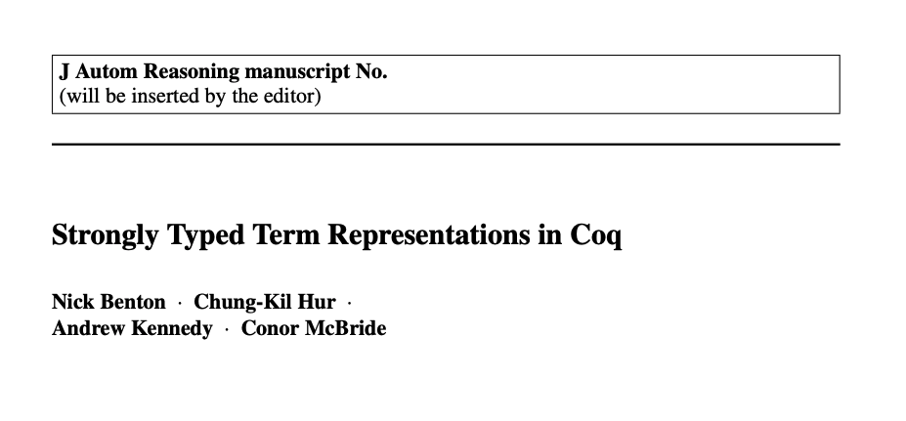
Our Guide
JAR August 2012, Volume 49, Issue 2, pp 141-159
upload.wikimedia.org/wikipedia/commons/9/98/Dragon_Harley_MS_3244.png
Notes:
When you take something from one context to another, you always learn something

Slide 6
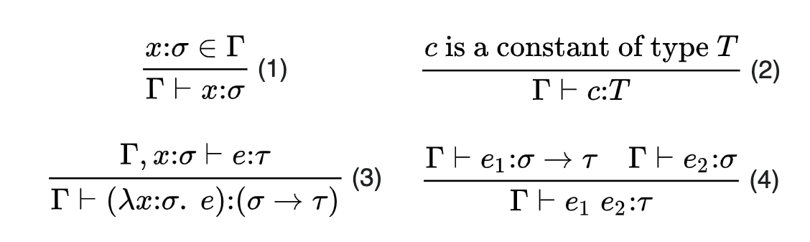
The Simply-Typed Lambda Calculus (STLC)
https://en.wikipedia.org/wiki/Simply_typed_lambda_calculus

Slide 7
Abstract Syntax of STLC
data Ty = IntTy | Ty :-> Ty
data Exp where
IntE :: Int -> Exp -- constant int, like "3"
VarE :: Idx -> Exp -- de Bruijn index (Nat)
LamE :: Ty -> Exp -> Exp -- "\(x::ty) -> e"
AppE :: Exp -> Exp -> Exp -- "e1 e2"
Simple.hs
<- Source file if you are following along using the repo

Slide 8
Abstract Syntax Example
\(x :: t1) -> x (\(y :: t2) -> x y)
LamE t1 (AppE (VarE 0) (LamE t2 (AppE (VarE 1) (VarE 0))))
Notes:
NOTE: there is no t1 and t2 that will make this term typecheck in Stlc.
This is not a strongly typed representation

Slide 9
Small-step reduction, closed terms
step :: Exp -> Maybe Exp
step (IntE x) = Nothing
step (VarE n) = error "Unbound variable"
step (LamE t e) = Nothing
step (AppE e1 e2) = Just $ stepApp e1 e2 where
stepApp :: Exp -> Exp -> Exp
stepApp (IntE x) e2 = error "Type error"
stepApp (VarE n) e2 = error "Unbound variable"
stepApp (LamE t e1) e2 = ???? – do a beta redex
stepApp (AppE e1' e2') e2 = AppE (stepApp e1' e2') e2
Simple.hs
Notes:
Find and apply the leftmost beta-redex

Slide 10
Substitution w/ de Bruijn indices
stepApp (LamE t e1) e2 = ???? -- substitute e2 into e1
Simple case: no lambdas in e1
… replace occurrences of "Var 0" with e2
… if e1 is not closed, decrement all other variables (we've removed a binder)
Towards generality: what if we need to traverse under a binder?
…replace occurrences of "Var 1" under the binder with e2
…if e1 is not closed, decrement variables >= 2 in e1, but leave 0 alone
…if e2 is not closed, increment free variables in e2 by 1

Slide 11

Substitution w/ de Bruijn indices
stepApp (LamE t e1) e2 = ???? -- substitute e2 into e1
Simple case: no lambdas in e1
… replace occurrences of "Var 0" with e2
… if e1 is not closed, decrement all other variables (we've removed a binder)
Towards generality: what if we need to traverse under n binders?
…replace occurrences of "Var n" under the binder with e2
…if e1 is not closed, decrement variables >= n+1 in e1, but leave 0..n-1 alone
…if e2 is not closed, increment free variables in e2 by n
Notes:
When things get scary, let's just close our eyes. We can ignore the details.

Slide 12
Substitution library
type Sub -- abstract type
applySub :: Sub -> Idx -> Exp -- lookup index
lift :: Sub -> Sub -- go under binder
subst :: Sub -> Exp -> Exp
subst s (IntE x) = IntE x
subst s (VarE x) = applySub s x
subst s (LamE ty e) = LamE ty (subst (lift s) e)
subst s (AppE e1 e2) = AppE (subst s e1) (subst s e2)
Simple.hs
Notes:
Substitution affects multiple indices, so view as a function from indices to expressions
What do you want -→ what to do for variables, and what to do at binders.

Slide 13
Substitution library
type Sub a -- 'a' is the AST type, like Exp
applySub :: SubstDB a => Sub a -> Idx -> a
lift :: SubstDB a => Sub a -> Sub a
class SubstDB a where
var :: Idx -> a -- var constructor
subst :: Sub a -> a -> a -- AST traversal
singleSub :: a -> Sub a -- create a substitution
Subst.hs

Slide 14
Using the library
import Subst
instance SubstDB Exp where
var = VarE
subst s (IntE x) = IntE x
subst s (VarE x) = applySub s x
subst s (LamE ty e) = LamE ty (subst (lift s) e)
subst s (AppE e1 e2) = AppE (subst s e1) (subst s e2)
Simple.hs
Notes:
I've gotten my wish...

Slide 15
Small-step reduction, closed terms
step :: Exp -> Maybe Exp
step (IntE x) = Nothing
step (VarE n) = error "Unbound variable"
step (LamE t e) = Nothing
step (AppE e1 e2) = Just $ stepApp e1 e2 where
stepApp :: Exp -> Exp -> Exp
stepApp (IntE x) e2 = error "Type error"
stepApp (VarE n) e2 = error "Unbound variable"
stepApp (LamE t e1) e2 = subst (singleSub e2) e1
stepApp (AppE e1' e2') e2 = AppE (stepApp e1' e2') e2
Simple.hs

Slide 16
A strongly-typed AST
Use types to rule out errors

Slide 17
Strongly-typed AST
data Ty = IntTy | Ty :-> Ty
data Exp :: [Ty] -> Ty -> Type where
IntE :: Int -> Exp g IntTy
VarE :: Idx g t -> Exp g t
LamE :: Sing (t1 :: Ty) -> Exp (t1:g) t2
-> Exp g (t1 :-> t2)
AppE :: Exp g (t1 :-> t2) -> Exp g t1
-> Exp g t2
The "typing context" nth Ty in list is type of nth bound variable
Index selects a type from the context (& must be in range)
Add a new type to the context in the body of the lambda (via cons)
I'll come back to this
SimpleTyped.hs

Slide 18
Strongly-typed substitution library
-- A reference to a specific element in the list
data Idx :: [k] -> k -> Type where
Z :: Idx (t:g) t
S :: Idx g t -> Idx (u:g) t
-- Idx has a polymorphic kind
Idx :: forall k. [k] -> k -> Type
Exp :: [Ty] -> Ty -> Type
SubstTyped.hs

Slide 19
Small-step reduction, closed terms
step :: Exp '[] t -> Maybe (Exp '[] t)
step (IntE x) = Nothing
step (VarE n) = case n of {} -- impossible
step (LamE t e) = Nothing
step (AppE e1 e2) = Just $ stepApp e1 e2 where
stepApp :: Exp '[] (t1 :-> t2) -> Exp '[] t1 -> Exp '[] t2
-- stepApp (IntE x) e2 = error "Type error"
stepApp (VarE n) e2 = case n of {} -- impossible
stepApp (LamE t e1) e2 = subst (singleSub e2) e1
stepApp (AppE e1' e2') e2 = AppE (stepApp e1' e2') e2
SimpleTyped.hs

Slide 20
Strongly-typed substitution library
-- Substitution applies to indices in context g1
-- and produces terms in context g2
type Sub (a::[k]->k->Type) (g1 :: [k]) (g2 :: [k])
class SubstDB (a :: [k] -> k -> Type) where
var :: Idx g t -> a g t
subst :: Sub a g1 g2 -> a g1 t -> a g2 t
singleSub :: a g t -> Sub a (t:g) g
Subst.hs

Slide 21
Strongly-typed substitution
instance SubstDB Exp where
var :: Idx g t -> Exp g t
var = VarE
subst :: Sub Exp g1 g2 -> Exp g1 t -> Exp g2 t
subst s (IntE x) = IntE x
subst s (VarE x) = applySub s x
subst s (LamE ty e) = LamE ty (subst (lift s) e)
subst s (AppE e1 e2) = AppE (subst s e1) (subst s e2)
SubstTyped.hs
Notes:
Only the types change, same definition of Subst as before
If we forget to use applySub, we will get a type error
If we forget to use lift, we will get a type error
If we forget to call subst recursively in App we will get a type error
As a library designer, this makes me really happy. My typed guide clients to a correct implementation.

Slide 22
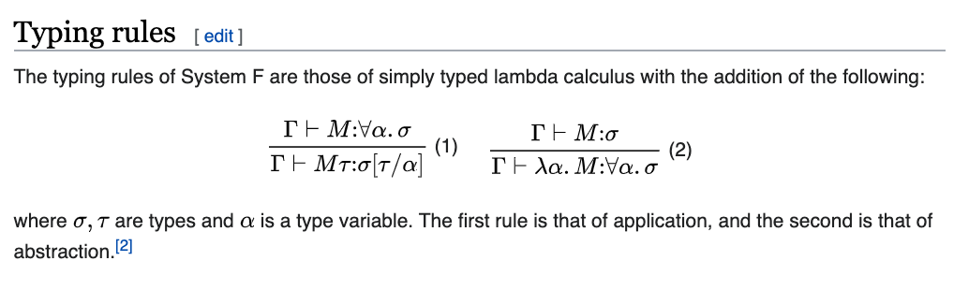
From STLC to System F
https://en.wikipedia.org/wiki/System_F

Slide 23
Strongly-typed System F
data Ty = IntTy | Ty :-> Ty | VarTy Idx | PolyTy Ty
data Exp :: [Ty] -> Ty -> Type where
IntE :: Int -> Exp g IntTy
VarE :: S.Idx g t -> Exp g t
LamE :: Sing (t1 :: Ty) -> Exp (t1:g) t2
-> Exp g (t1 :-> t2)
AppE :: Exp g (t1 :-> t2) -> Exp g t1
-> Exp g t2
(more)
"Weakly-typed" index
Same GADT parameters as STLC: Not tracking scoping of type variables
No change to existing STLC data constructors
More constructors to come
SimpleTyped.hs
Notes:
Qualify strongly-typed library with S.

Slide 24
Type substitution in types
data Ty = IntTy | Ty :-> Ty | VarTy Idx | PolyTy Ty
instance SubstDB Ty where
var = VarTy
subst s IntTy = IntTy
subst s (t1 :-> t2) = subst s t1 :-> subst s t2
subst s (VarTy x) = applySub s x
subst s (PolyTy t) = PolyTy (subst (lift s) t)
Poly.hs

Slide 25
Type substitution in types
$(singletons [d|
data Ty = IntTy | Ty :-> Ty | VarTy Idx | PolyTy Ty
instance SubstDB Ty where
var = VarTy
subst s IntTy = IntTy
subst s (t1 :-> t2) = subst s t1 :-> subst s t2
subst s (VarTy x) = applySub s x
subst s (PolyTy t) = PolyTy (subst (lift s) t)
|])
Poly.hs

Slide 26
Generated by Singletons
data STy :: Ty -> Type where -- generated
SIntTy :: STy IntTy
(:%->) :: STy a -> STy b -> STy (a :-> b)
SVarTy :: Sing n -> STy (VarTy n)
SPolyTy :: STy a -> STy (PolyTy a)
type family Sing (a :: k) :: Type -- in library
type instance Sing (a :: Ty) = STy a -- generated
exTy :: Sing (IntTy :-> IntTy) -- example
exTy = SIntTy :%-> SIntTy

Slide 27
Generated by Singletons
type family Subst (s :: Sub a) (x :: a) :: a
type instance Subst s IntTy = IntTy
type instance Subst s (t1 :-> t2) = Subst s t1 :-> Subst s t2
type instance Subst s (VarTy x) = ApplySubst s x
type instance Subst s (PolyTy t) = PolyTy (Subst (Lift s) t)
sSubst :: forall a (t1 :: Sub a) (t2 :: a).
SSubstDB a =>
Sing t1 -> Sing t2 -> Sing (Subst t1 t2)
sSubst s SIntTy = SIntTy
…

Slide 28
System F terms
data Ty = IntTy | Ty :-> Ty | VarTy Idx | PolyTy Ty
data Exp :: [Ty] -> Ty -> Type where
…
TyApp :: Exp g (PolyTy t1)
-> Sing (t2 :: Ty)
-> Exp g (Subst (SingleSub t2) t1)
TyLam :: Exp (IncList g) t
-> Exp g (PolyTy t)
Singleton type for Ty, via singletons library
Promoted versions of "subst" and "singleSub", via singletons library
Increment all type variables in the context (not shown)
PolyTyped.hs

Slide 29
Term substitution – straightforward*
instance S.SubstDB Exp where
var = VarE
subst s (IntE x) = IntE x
subst s (VarE x) = S.applySub s x
subst s (LamE ty e) = LamE ty (S.subst (S.lift s) e)
subst s (AppE e1 e2) = AppE (S.subst s e1) (S.subst s e2)
subst s (TyLam e) = TyLam (S.subst (incTy s) e)
subst s (TyApp e t) = TyApp (S.subst s e) t
*incTy has issues, will discuss later
PolyTyped.hs

Slide 30
Roar!
substTy :: forall g s ty. Sing (s :: Sub Ty) -> Exp g ty
-> Exp (Map (Subst s) g) (Subst s ty)
substTy s (IntE x) = IntE x
… -- other cases
substTy s (TyLam (e :: Exp (IncList g) t))
= TyLam (substTy (sLift s) e) -- TYPE ERROR
-- Have: Exp (Map (Subst (Lift s)) (IncList g)) (Subst (Lift s) t)
-- TyLam wants: Exp (IncList (Map (Subst s) g)) (Subst (Lift s) t)
to produce: Exp (Map (Subst s) g) (Subst s (PolyTy t))
PolyTyped.hs
Notes:
Type-level programming sometimes needs type-level reasoning.
This in not really a surprise. It's in the abstract/introduction of the Benton paper.

Slide 31
Need type-level reasoning
GHC cannot show these two types equal
Map (Subst (Lift s)) (IncList g) ~
IncList (Map (Subst s) g)
In Coq or Agda we would prove it (and Benton et al. do so)
Haskell is not a proof assistant, so what can we do?

Slide 32
Haskell is not a proof assistant
Get type class constraint solver to prove it?
Works for simple properties, but not here
Check the property at runtime?
Runtime cost for doing the check, typing context not available
Solution(?)
Axiom implemented by unsafeCoerce, carefully marked in a separate file
Dangerous; an invalid axiom could cause GHC to segfault
Justified via external means (proof in Coq version, QuickCheck tests, etc.)
prop_axiom1 :: Sub Ty -> [Ty] -> Bool
prop_axiom1 s g = map (subst (lift s)) (incList g) == incList (map (subst s) g)
Notes:
This is where I need to be really brave

Slide 33
What did we learn?
JAR August 2012, Volume 49, Issue 2, pp 141-159
upload.wikimedia.org/wikipedia/commons/9/98/Dragon_Harley_MS_3244.png

Slide 34
What did we learn?
Weak internal logic means that there will always be some programs out of reach of the GHC type checker
Weak internal logic means definitions can be simpler: Coq version must define renaming first, then substitution
Haskell type classes encourage a general-purpose library (i.e. SubstDB)
The GHC ecosystem includes profiling/benchmarking tools. How well does this representation work in practice?

Slide 35
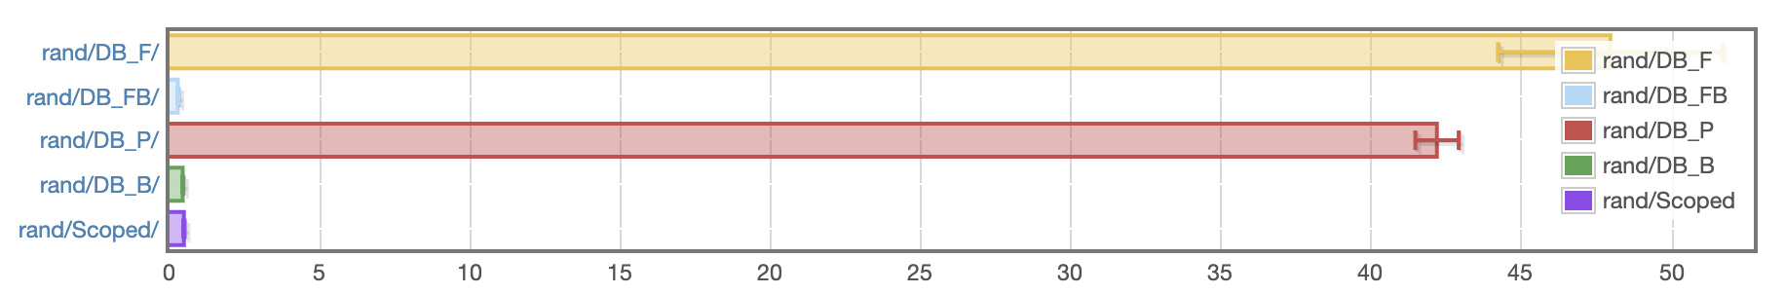
Benchmark – Random terms
Full normalization of 25 randomly generated, closed lambda terms (26-36 subst each)
time in ms
DB_F: represent substitutions with functions, as in Benton et al.
DB_FB: above, but delay substitutions at binders
DB_P: defunctionalize substitutions
DB_B: defunctionalize, delay at binders, & "smart" composition
Scoped: same as DB_B, but types ensure well-scoped terms
https://github.com/sweirich/lennart-lambda

Slide 36
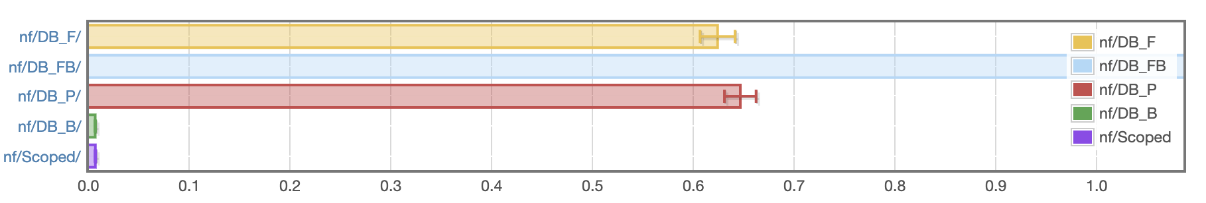
Benchmark – Pathological term
Full normalization of `factorial 6 == sum [1..37] + 17`, Church encoded (119,697 substs)
14 secs!!
time in seconds
DB_F: represent substitutions with functions, as in Benton et al.
DB_FB: above, but delay substitutions at binders
DB_P: defunctionalize substitutions
DB_B: defunctionalize, delay at binders, & "smart" composition
Scoped: same as DB_B, but types ensure well-scoped terms
https://github.com/sweirich/lennart-lambda

Slide 37
Related Work
Strongly-typed System F term representations
(additional references from Benton et al.)
Pfenning and Lee, Metacircularity in the polymorphic λ-calculus. Theoretical Computer Science 89 (1991) 137-159
Louis-Julien Guillemette, Stefan Monnier. A type-preserving compiler in Haskell. ICFP 2008
Libraries and tools for working generically with de Bruijn indices
Edward Kmett. "Bound" library for Haskell
Autosubst/Autosubst 2 tool for Coq
Allais, Chapman, McBride, McKinna. Type-and-scope safe programs and their proofs. CPP '17
Keuchel, Weirich, Schrijvers. Needle & Knot: Binder Boilerplate Tied Up. ESOP 2016

Slide 38

Conclusions
Strongly-typed System F demonstrates the limit of Dependent Haskell without extending the built-in proof theory
No proofs required for STLC
No proofs required for closed System F terms (step)
Type transformations require proofs (substTy, incTy, Cps)
Important to weigh tradeoffs
Strong types can rule out many bugs, but are axioms worth it?
Strongly-typed representations are compatible with optimization
https://github.com/sweirich/challenge/

